Slide 1
Three Choirs Festival, Hereford 2015
Hereford City Council presentation 13 January 2015
Clare Wichbold MBE
Chairman, Hereford Festival

Slide 2
Three Choirs Festival background
World’s oldest music festival
Three hundred years since the festival
was founded
Began with Vicars Choral who used to sing,
gamble and drink – but also raise money for charity
Rotates between Gloucester, Hereford and Worcester

Slide 3
How is the festival run?
Local committee of volunteers in each city
Supported by small team of professional staff
based in Gloucester
Hereford has separately constituted Friends committee to help raise funds for the festival
Singers in the festival chorus are all volunteers, supported by lay clerks from cathedral choirs

Slide 4
Hereford 2015 – a significant year!
300th anniversary festival in Hereford – but not
the 300th festival – yet….
Will sell over 25,000 tickets to festival events
Major interest already from overseas visitors and from across the country after initial publicity
BBC Radio 3 coverage anticipated to be more than ever before

Slide 5
What’s going to be happening? (1)
Festival takes place from 25 July to 1 August
Activities prior to the festival will be
used to showcase Hereford, including:
Launch of booking brochure in March
Dean’s sponsored walk in April
Three Cathedral Choirs Evensongs in May and June
Community activities such MusicLab

Slide 6
What’s going to be happening (2)
Festival programme itself includes:
Services – evensong, opening service, etc
Concerts and recitals
Gathering Wave
Lectures
Young musicians performances
Three Choirs Plus and MusicLab

Slide 7
Where are things taking place? (1)
Concerts and recitals in various venues:
Cathedral St Francis Xavier
Holy Trinity Leominster Priory
Dore Abbey All Saints

Slide 8
Where are things taking place? (2)
Other events and activities at:
Left Bank Hereford Academy
St John’s Methodist Church The Courtyard
St Peter Lugwardine St Peter’s Hereford
Bishop’s Palace High Town

Slide 9
What does this mean for Hereford?
The classical music world will be watching us
Professional musicians from around the world
will be visiting the city and county
Visitors coming to stay in local accommodation – hotels, guest houses, B&B, homestay
Economic impact from spend in shops, cafes, restaurants and pubs

Slide 10
Who are we working with?
Yourselves at the City Council
Herefordshire Council Music Pool
Hereford in Bloom Hereford College of Art
Herefordshire Guild of Craftsmen
Visit Herefordshire Chamber of Commerce
Herefordshire Regimental Museum
The list goes on!

Slide 11
What does this mean for the City Council?
Attending the Opening Service
Having a presence at events
Mayor’s reception for stewards
Reception for festival chorus after last main concert
Opportunities to showcase the City
Generous sponsorship of a concert during the week – thankyou!

Slide 12
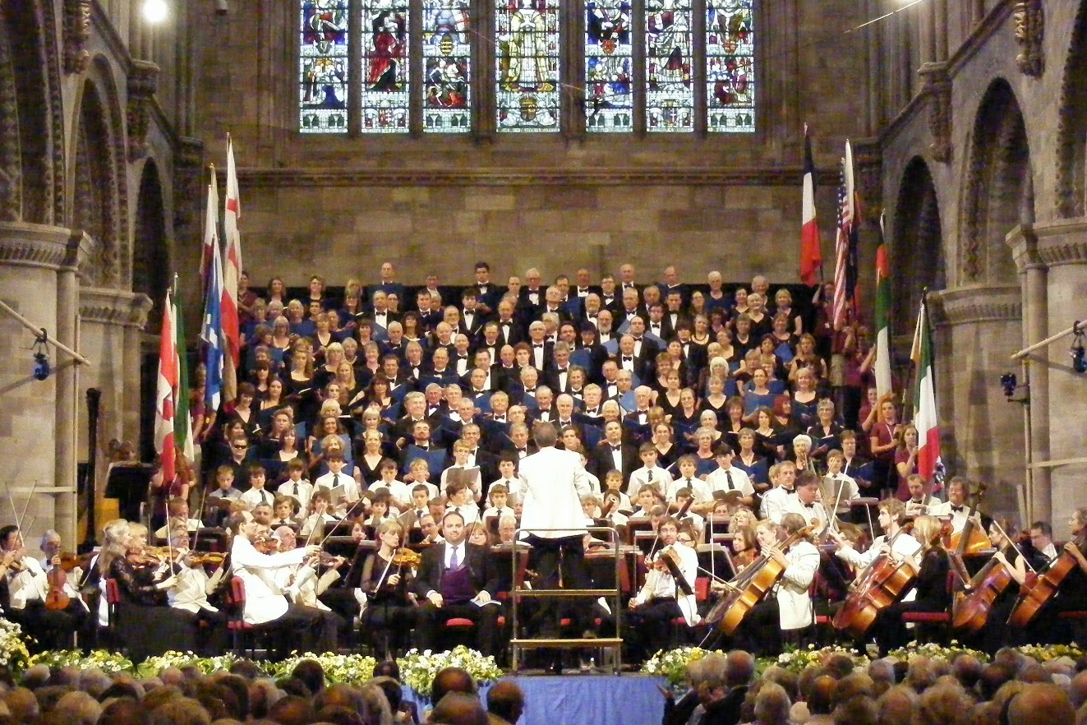
Questions?

